Slide 1


What Factors of MSA Attract Millennials
Hao Jin, Minzhi Meng, Weikang Hu, Yunliu Wu, Xingtao Liu
12/09/2019

Slide 2

Outline
Introduction
Literature Review
Data
Empirical Strategy
Regression Results & Discussion
Conclusion
2

Slide 3
Introduction
Background:
According to government data analyzed by the Pew Research Center, millennials, defined as people born between the years 1981 and 2000, overtook the Baby Boomers as largest adult population in the United States in 2019. Where young adults choose to live will have a significant and lasting impact on locations on which places grow, which stagnate, and which decline.

Slide 4
Introduction
“Youthification”:
Defined as the “influx of young adults into higher density” cities and neighborhoods. And in some ways these neighborhoods are “forever young,” where new cohorts of young people continue to move in as families and children cycle out in search of more space.

Slide 5
Introduction
Research methodology:
By using the fixed or random effect model in panel data, this project intent to know what are the main factors that attract young adults to live in an area.

Slide 6
Literature Review
1999: Determinants of Residential Satisfaction: Ordered Logit vs. Regression Models. The empirical analysis uses data drawn from the American Housing Survey (AHS) and ordered logit models (OLM). The results show that residential satisfaction is a complex construct, affected by a variety of environmental and socio‐demographic variables.
2001: The Migration of Young Adults from Non-Metropolitan Counties. This article examines young adult migration from non-metropolitan counties to either different non-metropolitan counties or to metropolitan areas. The results show that expected gains in initial earnings provide young entrants to the labor force with a marked incentive to migrate from their non-metropolitan counties of origin. The propensity to migrate is also sensitive to the costs of migration, which, in turn, are correlated with paternal education and the local presence of extended family.
2014: The regional migration of young adults in England and Wales (2002–2008): a ‘conveyor-belt’ of population redistribution? This paper calls for a more encompassing perspective of the regional migration patterns of young adults (16–24), extending studies of labour-motivated graduate migration.calculated changes at the local authority level by comparing ‘snap-shot’ cross-sections of GP registers, taken on 31st of each year (from the NHS Central Register – NHSCR).
Lu, M. (1999). Determinants of Residential Satisfaction: Ordered Logit vs. Regression Models. Growth and Change, 30(2), pp.264-287.
Mills, B. and Hazarika, G. (2001). The Migration of Young Adults from Non-Metropolitan Counties. American Journal of Agricultural Economics, 83(2), pp.329-340.
Smith, D. and Sage, J. (2014). The regional migration of young adults in England and Wales (2002-2008): a ‘conveyor-belt’ of population redistribution?. Children's Geographies, 12(1), pp.102-117.

Slide 7
Literature Review
2015: Finding the “Generationed City” The Form and Structure of Young Adult Settlement Patterns. This thesis examines the present patterns in the residential geographies of young adults in major cities in Canada and the United States. The geography of young adult settlement is strongly associated with mixed uses, dense housing forms and accessibility through public transit.
2017: Urban Revival in America, 2000 to 2010. This paper documents and explains the striking rise in the proclivity of college-educated individuals to reside near city centers since 2000. This paper shows that this recent urban revival is driven almost entirely by younger college graduates in larger cities.
2018: Millennial First-Time Homebuyers and Location Choice .The paper looks at whether Millennial first-time homebuyers (defined as those born between 1980 and 2000) are more likely to buy homes near city centers than their counterparts in Generation X. In a logistic regression controlling for age and generation, the paper estimate separate age and period effects. The paper also control for car ownership, income, credit score, mortgage size, mortgage payment, and student debt levels. Found that the odds Millennials buy near city centers 21 percent higher than Generation X. This suggests that as Millennials purchase homes, they do not move to the suburbs at the same rate as Generation X.
Walter-Joseph, R. (2015). Finding the “Generationed City”: The Form and Structure of Young Adult Settlement Patterns. [online] Hdl.handle.net. Available at: http://hdl.handle.net/10012/9275 [Accessed 8 Dec. 2019].
Couture, V. and Handbury, J. (2017). Urban Revival in America, 2000 to 2010.
Raymond, E., Dill, J. and Lee, Y. (2018). Millennial First-Time Homebuyers and Location Choice. Journal of Planning Education and Research, pp.0739456X1880775.

Slide 8
Literature Review
2018: Are Millennials Coming to Town? Residential Location Choice of Young Adults. This article empirically examines the generational residential patterns using a multinomial logistic regression, suggesting the generational characteristics of the Millennials, at least partially, explain their inclination to choose city center over suburbs.This article provides a detailed analysis of the past, current, and future geographic population distribution, focusing on the young adults. Results show that millennials tend to prefer city centers.
2018: Are Milliennials move to more urbanized and transit-oriented counties? Recent studies show that two distinct narratives have emerged about the millennials’ behavior, attitudes, and preferences regarding their choice of residence and transportation. The push-pull regression models show that the effects of the county characteristics on migration are often significant but modest.
2019: Urban revival by Millennials? Intraurban net migration patterns of young adults, 1980–2010. This study investigates neighborhood scale net migration of young adults in the top 20 urbanized areas (UAs) in the United States between 1980 and 2010. Both descriptive and regression analyses show that Generation Xers and Millennials were more likely to net migrate into central locations and less aversive to high density at their young ages than late boomers were in the 1980s.
Lee, Y., Lee, B. and Shubho, M. (2019). Urban revival by Millennials? Intraurban net migration patterns of young adults, 1980–2010. Journal of Regional Science, 59(3), pp.538-566.
Lee, H. (2018). Are Millennials Coming to Town? Residential Location Choice of Young Adults. Urban Affairs Review, p.107808741878766.
Raymond, E., Dill, J. and Lee, Y. (2018). Millennial First-Time Homebuyers and Location Choice. Journal of Planning Education and Research, pp.0739456X1880775.

Slide 9


Data Source
American Community Survey
The American Community Survey (ACS) is an ongoing survey that provides vital information on a yearly basis about our nation and its people. Every year, the U.S. Census Bureau contacts over 3.5 million households across the country to participate in the American Community Survey. Through the ACS, we know more about jobs and occupations, educational attainment, veterans, whether people own or rent their homes, and other topics.
IPUMS USA
The Integrated Public Use Microdata Series (IPUMS USA) consists of more than fifty high-precision samples of the American population drawn from fifteen federal censuses and from the American Community Surveys of 2000-Present.

Slide 10

Data Source
U.S. Bureau of Economic Analysis
BEA produces economic accounts statistics that enable government and business decision-makers, researchers, and the American public to follow and understand the performance of the nation's economy. To do this, BEA collects source data, conducts research and analysis, develops and implements estimation methodologies, and disseminates statistics to the public. Real gdp real price level

Slide 11
Data
Data Selection
We chose American Community Survey 2012-2017 samples. Each sample is 1-in-100 national random sample of the population. Each sample includes 3 million individuals and their personal information such as gender, race, residency, education, work, income, migration, etc. We aggerated each sample based on metropolitans and our data contains 258 metropolitans.

Slide 12
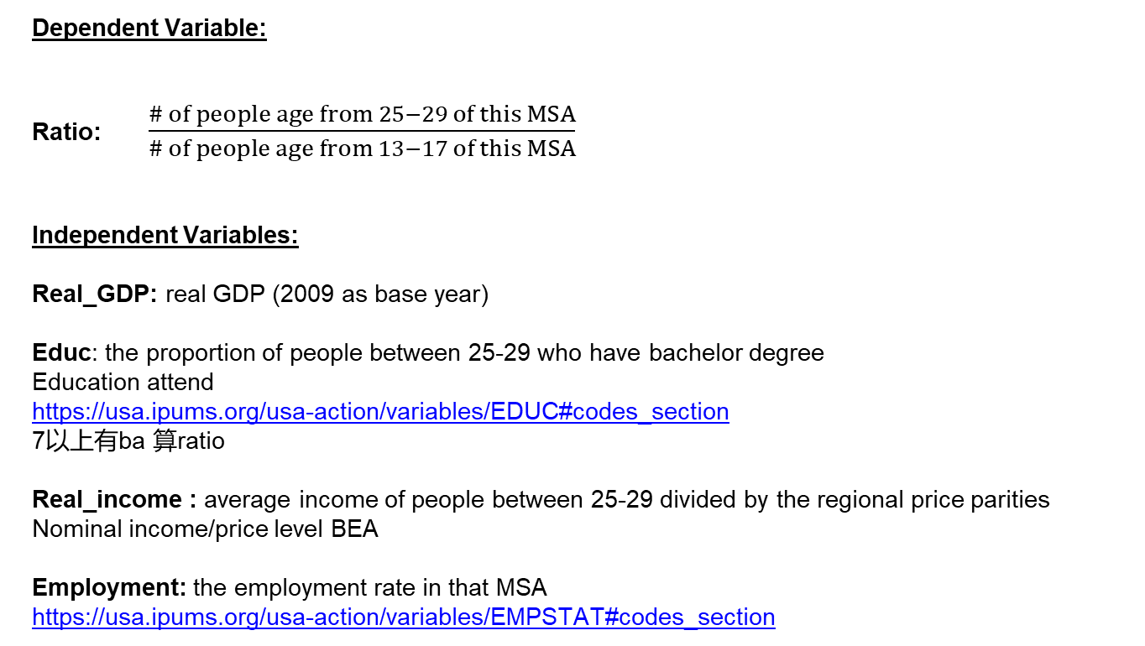

Data
Dependent Variable:
Ratio: $\frac{\# of people age from 25−29 of this MSA}{\# of people age from 13−17 of this MSA}$
Independent Variables:
Real_GDP: real GDP (2009 as base year)
Educ: the proportion of people between 25-29 who have bachelor degree
Education attend
https://usa.ipums.org/usa-action/variables/EDUC#codes_section
7以上有ba 算ratio
Real_income : average income of people between 25-29 divided by the regional price parities
Nominal income/price level BEA
Employment: the employment rate in that MSA
https://usa.ipums.org/usa-action/variables/EMPSTAT#codes_section

Slide 13





Data
Independent Variables:
Lnpopulation: the log form of sample size for each metropolitan area
Immigration: the percentage of people between 25-29 who were born in foreign country
Birth place
Children: the percentage of people under 12 in this MSA
College: the percentage of people between 18-22 who is in college
https://usa.ipums.org/usa-action/variables/BPL#codes_section
<100
Transportation: the average travel time to work for people between 25-29
Travel time
Hourswork: the average hours of work per week for people between 25-29
Nightlife: the percentage of people worked as bartender in this MSA.
ACS/PRCS Occupation Codes 4040
https://usa.ipums.org/usa/volii/occ_acs.shtml

Slide 14
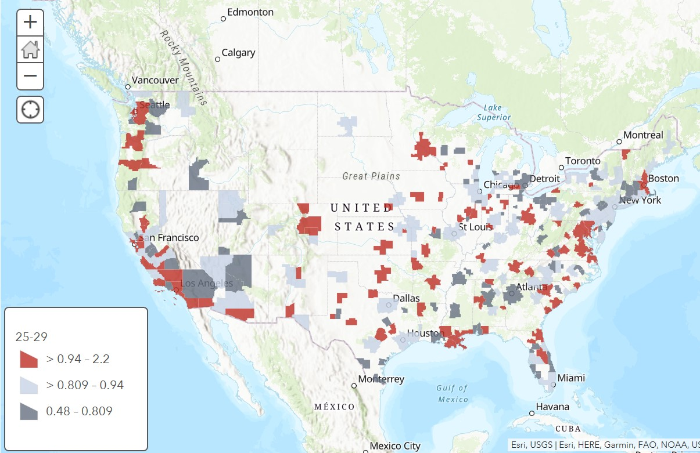

Slide 15
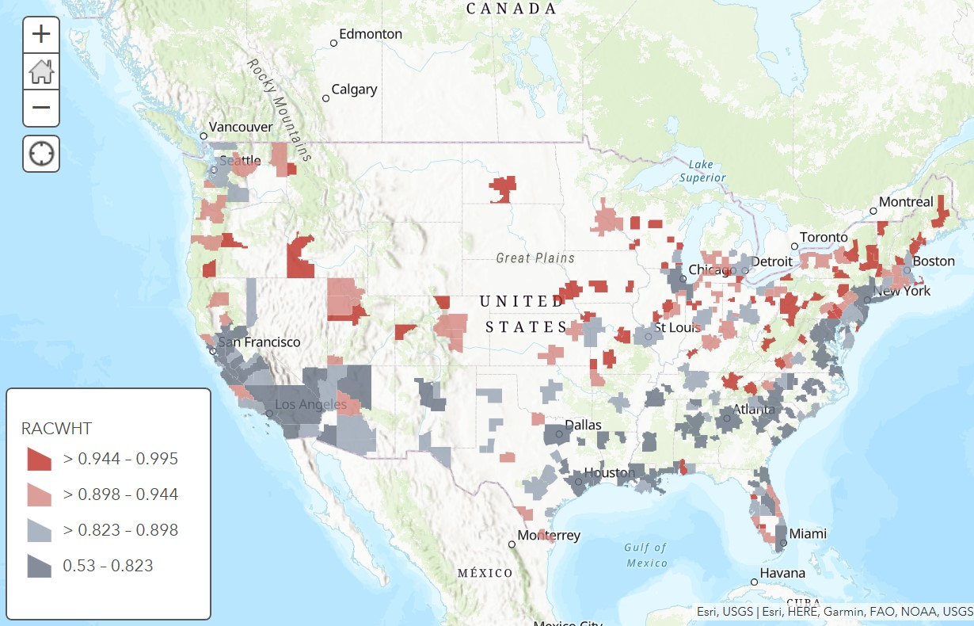

Slide 16
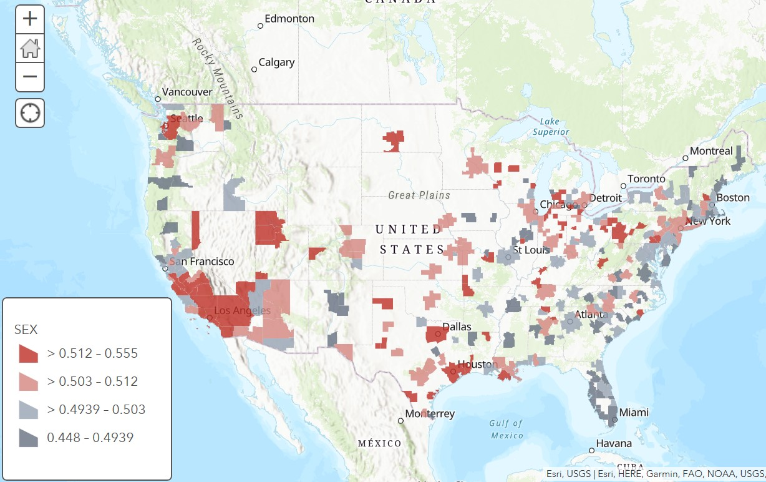

Slide 17
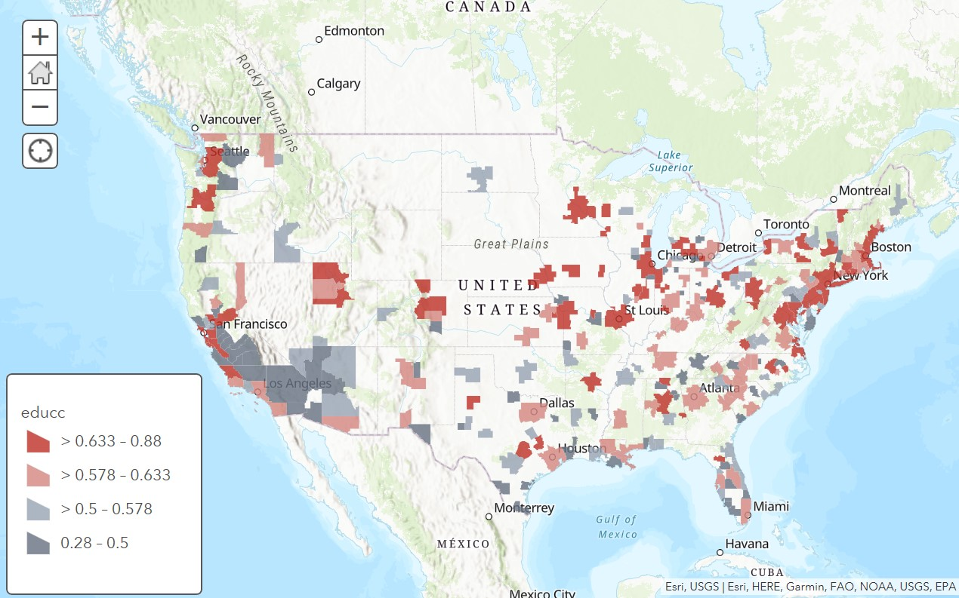

Slide 18
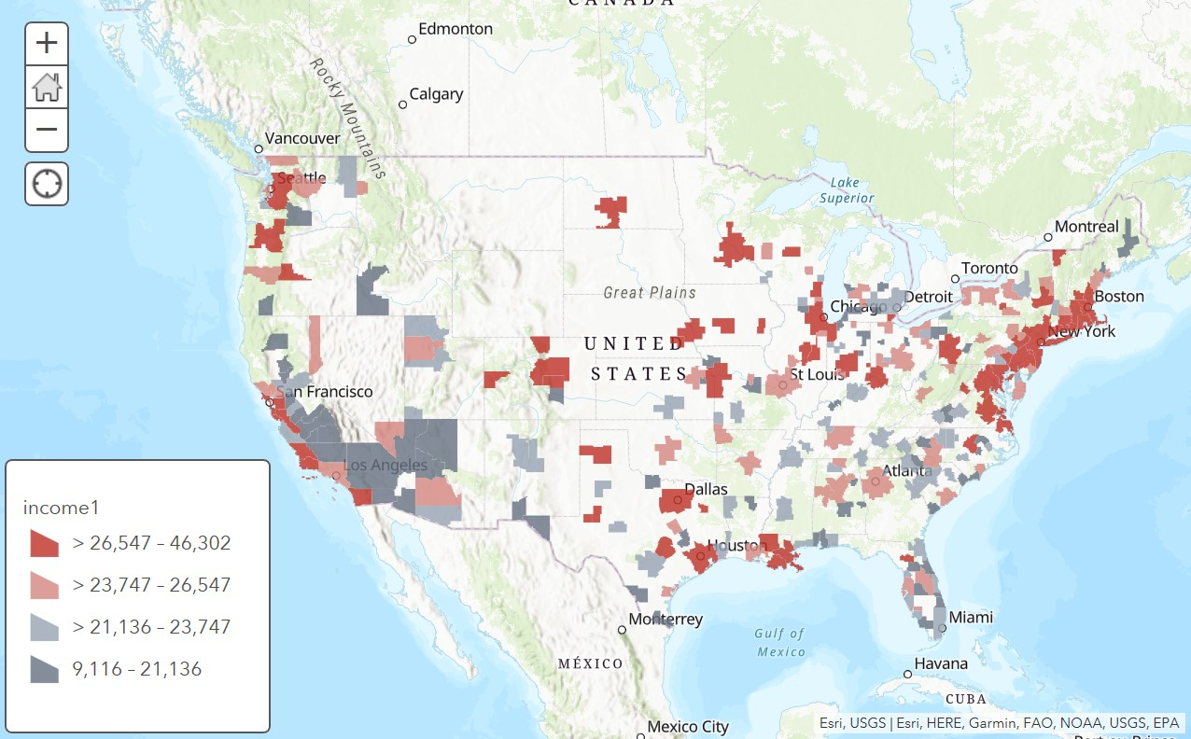

Slide 19
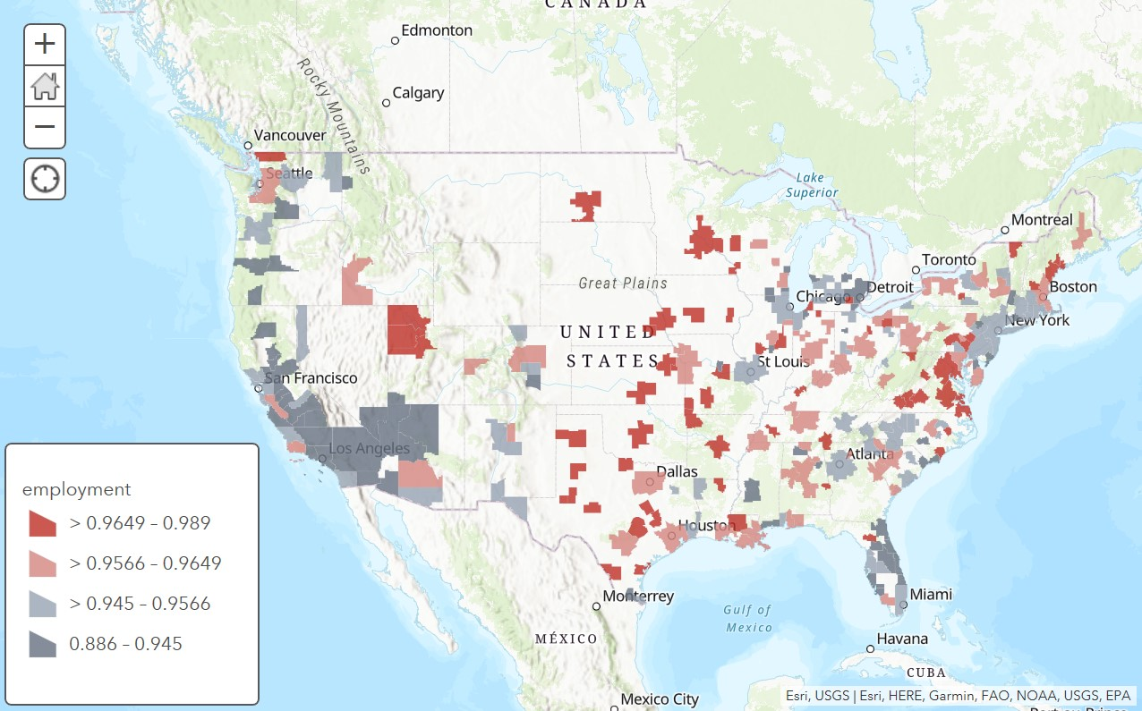

Slide 20
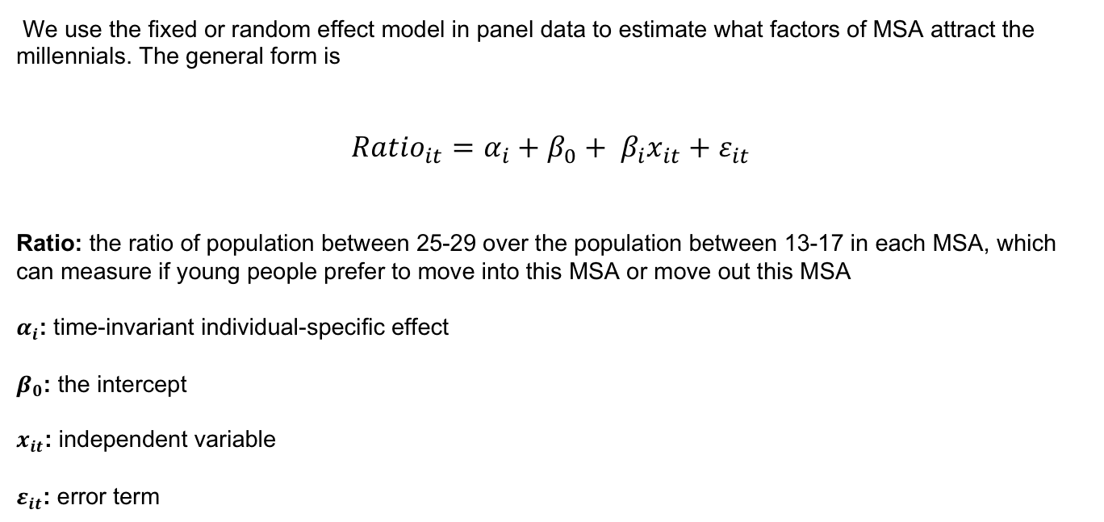
Empirical Strategy
We use the fixed or random effect model in panel data to estimate what factors of MSA attract the millennials. The general form is
$${Ratio}_{it}=α_{i}+β_{0}+ β_{i}x_{it}+ε_{it}$$
Ratio: the ratio of population between 25-29 over the population between 13-17 in each MSA, which can measure if young people prefer to move into this MSA or move out this MSA
$α_{i}$: time-invariant individual-specific effect
$β_{0}$: the intercept
$x_{it}$: independent variable
$ε_{it}$: error term

Slide 21
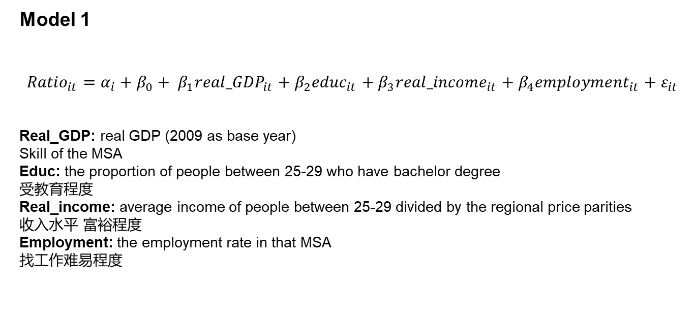
Empirical Strategy
Model 1
${Ratio}_{it}=α_{i}+β_{0}+ β_{1}{real_GDP}_{it}+{β_{2}educ}_{it}+{β_{3}real_income}_{it}+{β_{4}employment}_{it}+ε_{it}$ =
Real_GDP: real GDP (2009 as base year)
Skill of the MSA
Educ: the proportion of people between 25-29 who have bachelor degree
受教育程度
Real_income: average income of people between 25-29 divided by the regional price parities
收入水平 富裕程度
Employment: the employment rate in that MSA
找工作难易程度

Slide 22
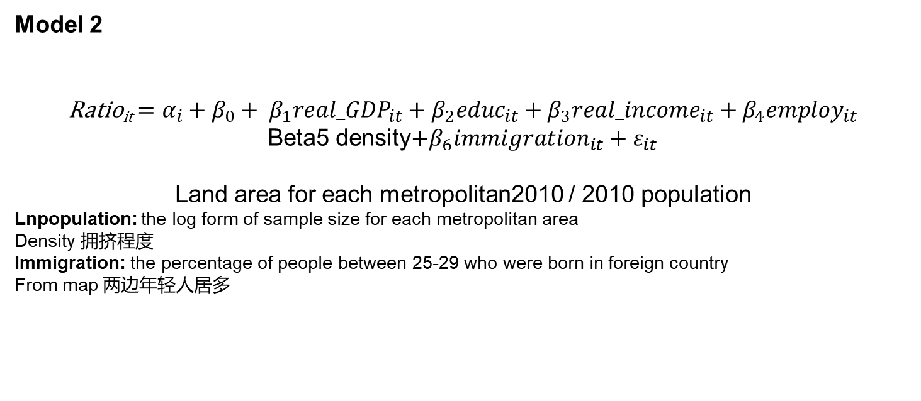
Empirical Strategy
Model 2
Ratio_{it}$=α_{i}+β_{0}+ β_{1}{real_GDP}_{it}+{β_{2}educ}_{it}+{β_{3}real_income}_{it}+{β_{4}employ}_{it}$
Beta5 density$+{β_{6}immigration}_{it}+ε_{it}$
Land area for each metropolitan2010 / 2010 population
Lnpopulation: the log form of sample size for each metropolitan area
Density 拥挤程度
Immigration: the percentage of people between 25-29 who were born in foreign country
From map 两边年轻人居多

Slide 23
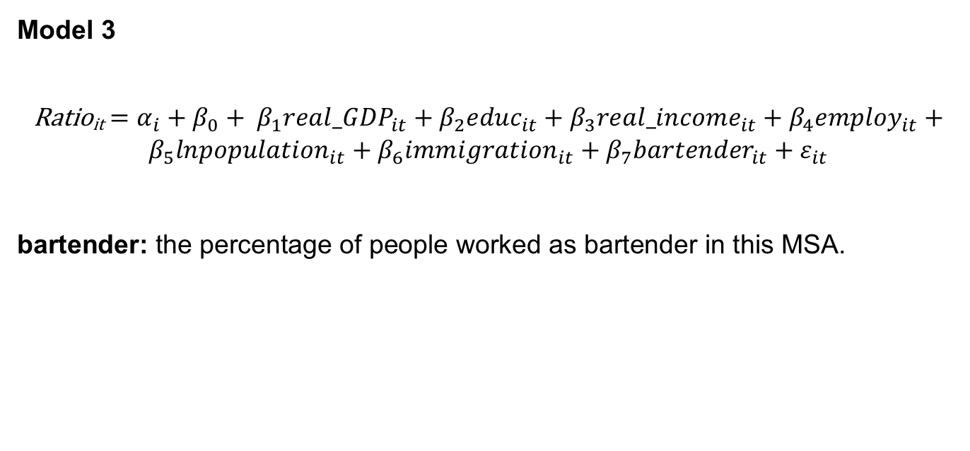
Empirical Strategy
Model 3
Ratio_{it}$=α_{i}+β_{0}+ β_{1}{real_GDP}_{it}+{β_{2}educ}_{it}+{β_{3}real_income}_{it}+{β_{4}employ}_{it}+{β_{5}lnpopulation}_{it}+{β_{6}immigration}_{it}+{{β_{7}bartender}_{it}+ε}_{it}$
bartender: the percentage of people worked as bartender in this MSA.

Slide 24
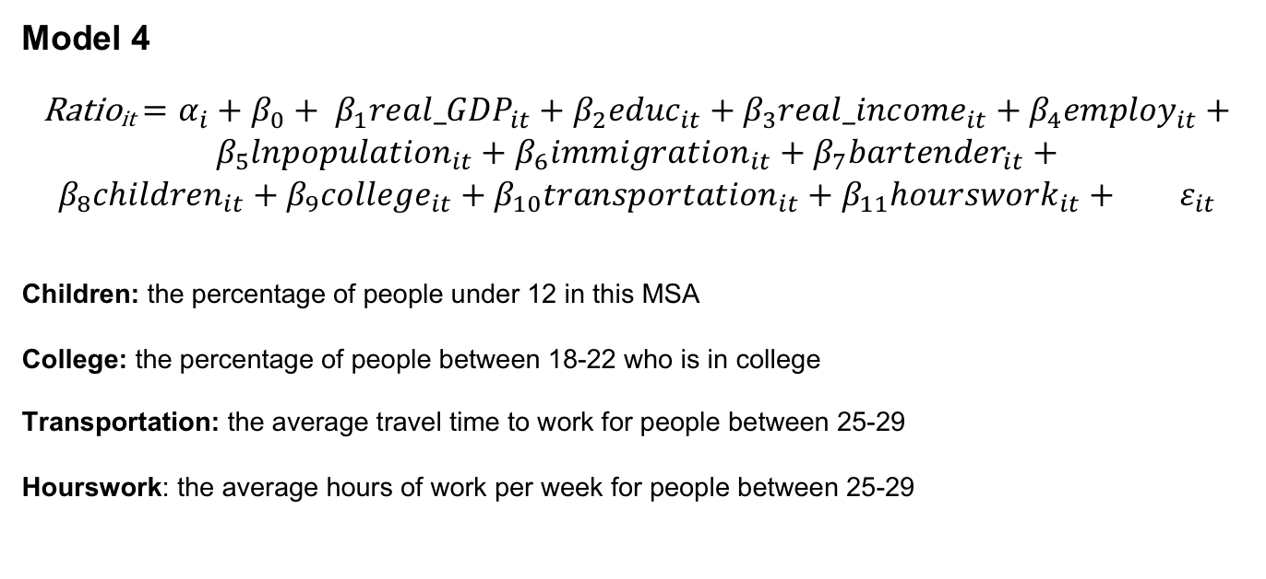
Empirical Strategy
Model 4
Ratio_{it}$=α_{i}+β_{0}+ β_{1}{real_GDP}_{it}+{β_{2}educ}_{it}+{β_{3}real_income}_{it}+{β_{4}employ}_{it}+{β_{5}lnpopulation}_{it}+{β_{6}immigration}_{it}+{β_{7}bartender}_{it}+β_{8}{{children}_{it}+{β_{9}college}_{it}+{β_{10}transportation}_{it}+{β_{11}hourswork}_{it}+{}_{}ε}_{it}$
Children: the percentage of people under 12 in this MSA
College: the percentage of people between 18-22 who is in college
Transportation: the average travel time to work for people between 25-29
Hourswork: the average hours of work per week for people between 25-29

Slide 25
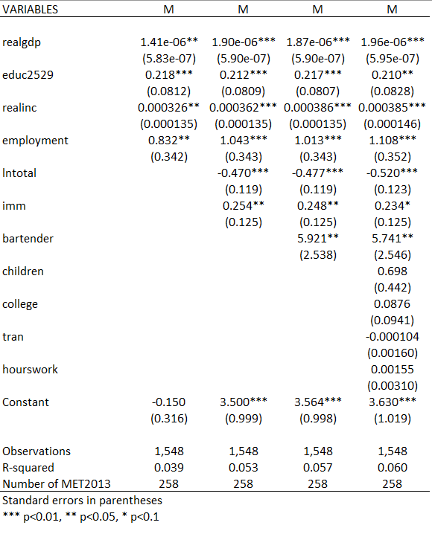

Regression Results

Slide 26
Regression Results
For the 4 models above, coefficients for real GDP is all positive and significant, which means that when GDP level increases by 10 billion, the percentage of young people moving into this MSA will increase by 1.92%.
Education also has a significant positive effect. When millennials with bachelor degree increase by 1%, young people moving into this MSA increase by 0.21%
Income and employment also increase the percentage of young people. (every 100 income for a increase of 3%).

Slide 27
Regression Results
The density of people in a MSA has a negative effect on ratio of millennials. A 1% increase in population density of a MSA will result in a 0.5% decrease of young people ratio.
When ratio of foreign born millennials increase by 1%, 0.25% more young people will be attracted.
Bartender which can be a measure of nightlife and entertainment. A 1% increase in bartender number will increase the ratio by 5%.

Slide 28
Regression Results
Overall, large MSAs seem to be attractive for young people. (GDP level can be a measure of the size of MSA)
Young people also tends to move to MSAs where there are higher rate of educated people, where they can earn more money, where they can easier to find a job.
Places with less population density attract more millennials where they can get more room of themselves.
Colorful and relaxing nightlife and entertainment lure more young people.
Places with more diversified races seem to attracting young people.

Slide 29

Conclusion
Millennials Prefer of MSA:
More Prosperity and larger size
Higher real income and employment rate
More educated people
More nightlife activities
Millennials Disfavor of MSA:
Density

